Slide 1



2024 CFISD
Livestock
Show

Slide 2


Slide 3


Usernames
Facebook- Cypress Woods FFA
Instagram- @cywoodsffa
Twitter- @cywoodsffa
Tik Tok- @cywoodsffa212
cypresswoods.ffanow.org

Slide 4

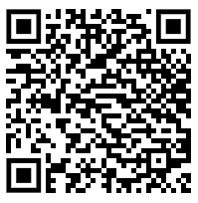
LSA Website
Find the rulebook, entry forms, district barn info, and so much more below!

Slide 5


Join our Remind!!
Text the number 81010 with the message @cwffa2024
Please put your real first and last name and designate if you are the student or parent.

Slide 6

Important Dates
  September 14- Forms and payment due for lambs, goats, and hogs
  October 4- Draw for selection numbers at the Exhibit Center
  October 5- Goat Selection at Exhibit Center
  October 6- Lamb Selection at Exhibit Center
  October 7- Pig Selection at Exhibit Center
  November 1-Deadline for Breeding Rabbit Ownership/Class 4 Horticulture started/ Heifer Registration
  January 31-February 3- Livestock Show

Slide 7
Expectations
  This is a family effort!
  Students must feed their project twice a day!
  Students must clean their animal’s pen no less than once every day and area around pen swept and kept clean
  Maintain a regular regime when feeding!
  Exercise and training is a must
  Responsibility, leadership, time management, budgeting are all gained from their experience with an SAE ( Supervised Agriculture Experience).

Slide 8
What are Livestock Animals?
Livestock are domesticated animals raised in an agricultural setting to produce labor and commodities such as meat, eggs, milk, fur, leather, and wool
THIS IS A TERMINAL SHOW

Slide 9
Premium Auction
  All grand and reserve market champions and horticulture projects must sell in the premium sale. A student may only sell a maximum of two projects in the premium sale on the sale date. The only exception will be if a student has more than two champions.
  The grand and reserve horticulture projects will also sell in the premium sale.
  “Up to 25%, with a minimum of 10 and a maximum of 25 animals per market division, will sell in the premium auction”
  We encourage all students to invite MANY buyers out to our sale. This greatly helps YOU out ultimately.

Slide 10
Freezer Sale
  If you do not make the premium auction, you will sell your market animal in the freezer sale. Anyone can purchase your animal if you do
  Students must turn in any pre-sale forms at check-in to guarantee their buyer’s purchase of the animal in the freezer sale. After that point, it is understood that LSA staff and/or sales committee members have permission to complete paperwork to sell the animal to any willing buyer.

Slide 11
Freezer Sale Prices
  Steers $3.00 per pound (weight set at time of weigh-in for show)
  Swine $450.00 per head
  Lambs $400.00 per head
  Goats $400.00 per head
  Broilers $150.00 per pen (students will deliver 5 broilers)
  Turkeys $150.00 per head
  Market Rabbits $150.00 per pen of 3

Slide 12
Lamb, Goat, & Pig Dewormer
All students with a lamb, goat or pig will charged $20 on schoolcash for dewormer. This will also cover most other medications that we may give out.

Slide 13
Items to Purchase for Pigs | Approximate Cost
Animal | $350
Pen Rent ($100 is refundable IF you clean your pen out completely after show) | $150
Feed Storage Container (metal trash can with a chain and lock) | $40
Shavings rake (pooper scooper) | $15
Shavings (4 bags at a time, can be changed every 1-2 weeks depending) | $5/bag
Feed | $22-$30
Feed trough with hog panel | $25
Dewormers/Meds. (we provide dewormer and most shots that you get from a vet) | $20
Fan | $25
Grooming Products (shampoo, conditioner, rice root brush) | $40
Total | $1000-$2000

Slide 14
Items to Purchase for Goats | Approximate Cost
Animal | $675
Pen Rent ($100 is refundable IF you clean your pen out completely after show) | $150
Feed Storage Container (metal trash can with a chain and lock) & 1 lb coffee can to scoop feed | $40
Shavings rake (pooper scooper) | $15
Shavings (2 bags at a time, can be changed every 1-2 weeks depending) | $7/bag
Feed (price per bag) | $22-$30
Feed trough with panel and water bucket | $35
Dewormers/Meds. (we provide dewormer and most shots that you get from a vet) | $20
Miscellaneous products (blankets, muzzles, show chain, halters) | $75
Grooming Products (shampoo, conditioner, rake style brush) | $40
Total | $1150-1300

Slide 15
Items to Purchase for Lambs | Approximate Cost
Animal | $394
Pen Rent ($100 is refundable IF you clean your pen out completely after show) | $150
Feed Storage Container (metal trash can with a chain and lock) & 1 lb coffee can to scoop feed | $40
Shavings rake (pooper scooper) | $15
Shavings (2 bags at a time, can be changed every 1-2 weeks depending) | $7/bag
Feed (price per bag) | $22-$30
Feed trough with panel and water bucket | $35
Dewormers/Meds. (we provide dewormer and most shots that you get from a vet) | $20
Miscellaneous products (blankets, muzzles, leg wraps, halters) | $75
Grooming Products (shampoo, conditioner, rake style brush) | $40
Total | $1150-1300

Slide 16
Broilers
  $45 per box (recommend getting 2)= $90
  1 box= 25 head of chickens
  $25 entry fee
  Feed and Supplements = $600
  Feed Containers (4-6 @ $25)= $100
  Shavings (4 bags/pen every 3rd week)- $32
  Total- $822
  MUST HAVE OWN HOUSING
  These costs will be dependent on the type and size of pen

Slide 17
Rabbits
  1 buck and 2 does- $150-$400
  Recommended to get at least a breeding trio (1 male, 2 females)
  Students must supply housing- no school district facilities
  Feed- 5 @ $20/bag= $100
  Feed Containers (1/pen)- $30-$60
  Water Containers (1/pen) $30-$60
  Entry fee- $25 for 1 breeding rabbit, $25 for market rabbits
  Total- $335-$800
  Cage costs vary
  Must own BREEDERS by November 1st, MARKET rabbits by January 10

Slide 18
Rabbit Remind!
Text the number 81010 with the message @cwrabbits
Please put your real first and last name and designate if you are the student or parent.

Slide 19
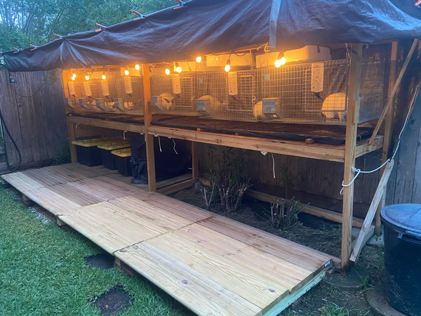
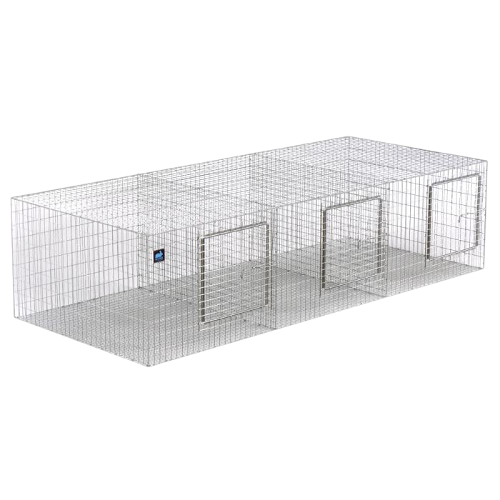
RABBIT HOUSING
https://www.allthingsbunnies.com/rabbit-cages-carts-carriers-playpens-s/1827.htm?searching=Y&sort=13&cat=1827&show=30&page=2
Must be up off the ground and have a roof over the top. Cage costs vary but are about $50 per rabbit (not including any wooden legs or roofing material)
https://www.kwcages.com/cages.html

Slide 20
Breeding Info
IF you are wanting to breed your own meat rabbits for a meat pen, you will need to breed October 23-27 and put nestboxes in November 13
use nestboxes with wire bottom for easy cleaning
nestbox- https://www.allthingsbunnies.com/Wood-Rabbit-Nest-Boxes-p/nb116.htm

Slide 21
Ag Mech
  $25 entry fee
  lots of different classes/divisions- Look here!
  Start whenever, but make sure you talk with Mr. Meischen and take pictures in proper safety gear as you create your project!
  Will need to put plans, billing materials, and pictures in a portfolio

Slide 22
Horticulture
  $25 entry fee
  lots of different classes/divisions- Look here!
  Start whenever, but make sure you talk with an Ag Teacher and take pictures as you create your project!
  Will need to put billing materials, and pictures in a portfolio

